Slide 1
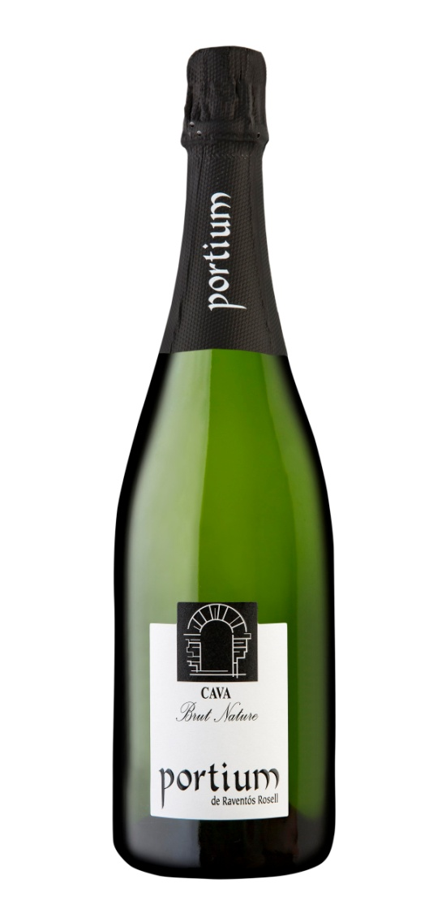
Portium B/Nat
Origin: D.O. Cava, Catalunya, Barcelona
Spain.
Varietal content:;
30% Xarel·lo
45% Macabeu
5% Chardonnay
20% Parellada
Vineyard features:
The country house where our cavas are
Located is surrounded by vineyards that
Cover around 50 hectares. Being so close
To the field allows a fast collection of
The grape at it´s best condition.
Most of the vineyards were planted during the late 80´S.These plantations
Are located on a clay-loam soil
TECHNICAL FEATURES:
Alcohol by volume; 11,5 % vol
Acidity; 6 g/l
Total Sugar ; 2 g/l
Sorbic Acid: No
Aging: At least 9 months
Tasting notes:
Of a pale straw color, with a white Fresh fruit aroma and a light pastry.
Base due to it´s aging with lees during The second fermentation.
In the palate, it´s a fresh cava, dry and witch a pleasant acidity.
Logistic information:
Bottle:
Height; 320 mm.
Diameter; 88,4 mm.
Empty bottle weight; 900g.
Full bottle weight; 1640 g.
Bottle capacity; 750 ml.
Cork type: 1 washer
EAN Code Bot .8425070001368
Boxs:
Height; 325 mm.
Length; 270 mm.
Width; 185 mm.
Bott for box; 6 bottles
Full box weigh* 6 bottles; 10,1 kg.
Código EAN 68425070001360
Europalet:
Height; 1770 mm.
Boxes for storey; 17
Storeys; 5
Boxes for palet; 85
Total estimated weight.; 879 kg.

